Slide 1
NLP

Slide 2
Introduction to NLP
Dependency Parsing

Slide 3
Motivation
Constituent parsing vs. Dependency parsing
PP attachment
CP – multiple differences between the two parse trees
DP – the difference is in just one word (preposition) that needs to be reattached
CC attachment
CP – multiple differences between the two parse trees
DP – multiple dependencies; furthermore the choice of a head is unclear: either the first N or the CC

Slide 4
Techniques (1)
Constraint-based methods
Maruyama 1990, Karlsson 1990
Example
word(pos(x)) = DET ⇒(label(X) = NMOD, word(mod(x)) = NN, pos(x) < mod(x))
A determiner (DET) modifies a noun (NN) on the right with the label NMOD.
NP-complete problem; heuristics needed
Constraint graph
For initial constraint graph using a core grammar: nodes, domains, constraints
Find an assignment that doesn’t contradict any constraints. If more than one assignment exists, add more constraints.
Notes:
CHECK!

Slide 5
Classic Techniques
Dynamic programming
CKY – similar to lexicalized PCFG, cubic complexity (Eisner 96)
nsubj
dobj
likes
→
Mary likes cats
nsubj
dobj
Mary likes cats
Notes:
REMOVE

Slide 6
Eisner 1996
Two CKY charts
one for “complete” items (head at “tall” end), there may be missing children on that side)
and one for “incomplete” items (arc from “tall” to “short” end), both sides may be missing children
Keep track whether the head is on the left or the right
hence the chart has an additional dimension of size 2 (left arc and right arc)

Slide 7


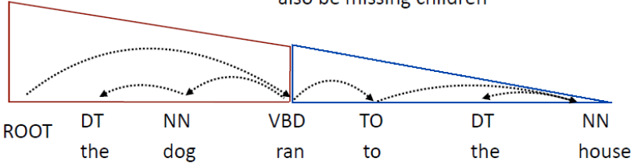
Example
Two complete items, connected with an arc turn into an incomplete item
A complete item + an incomplete item turn into a complete item
Full tree
[Example from Greg Durrrett]

Slide 8
Graph-based Dependency Parsing
McDonald et al. 2005
Dependency parsing is equivalent to search for a maximum spanning tree (MST) in a directed graph.
Efficient algorithm for finding MST for directed graphs
Chu and Liu (1965) and Edmonds (1967) give an.

Slide 9
MST Parser example
Consider the sentence “John saw Mary”
Recursively remove cycle
The Chu-Liu-Edmonds algorithm gives the MST on the right hand side (right). This is in general a non-projective tree.
9
root
10
root
30
10
9
20
saw
30
0
saw
30
John
Mary
30
John
Mary
11
3

Slide 13
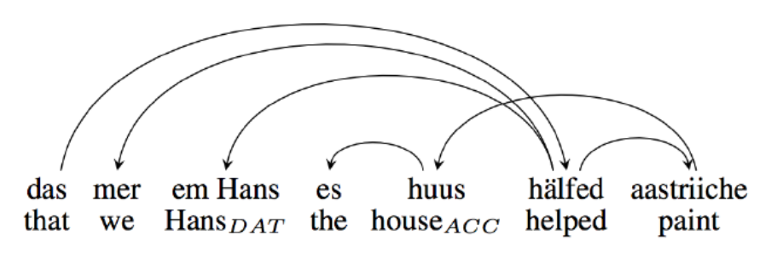
Notes
Complexity
Interestingly, MST is O(n²), compared with O(n³) for Eisner, even though MST is non-projective.
Example of a highly non-projective language
Swiss German
[example from Pitler 2013]

Slide 14
NLP

